Slide 1
Sustainable Applications That Work
AEDGS-Net Zero-Zero-Carb Designs
London Ontario Chapter
Terry E. Townsend, P.E., FASHRAE, LEED®AP, NEBB Cx-CP & RCx-CP
November 25, 2024

Slide 2
Sustainable Applications that Work - AEDGs to Net-Zero Energy to Zero-Carb-Designed Buildings
A Sustainable Future is no longer just a topic for discussion but rather a serious global concern. It is now time for definitive technical guidance, innovative engineering applications and leading-edge research to be initiated as the principal focus of a global technical organization……. ASHRAE

Slide 3
ASHRAE’s Position…
Eliminating GHG emissions from the built environment is essential to address climate change
Notes:
ASHRAE’s position is simple. Eliminating GHG emissions from the built environment is essential to address climate change.

Slide 4
Our goals…
2030
the global built environment must halve its 2015 GHG emissions
All new buildings must be NZE
Widespread EE retrofits of existing assets
New construction embodied carbon must be reduced by at least 40%
2050
all new and existing assets must be net zero GHG emissions across the whole life cycle
Notes:
By 2030, the global built environment must halve its 2015 GHG emissions, whereby
all new buildings must be net zero GHG emissions in operation,
widespread energy-efficiency retrofits of existing assets must be well underway, and
embodied carbon of new construction must be reduced by at least 40%.
By 2050, at the latest, all new and existing assets must be net zero GHG emissions across the whole life cycle.

Slide 5
Why Should Architects and Engineers be Concerned?
Buildings consume:
40% of all energy used and 70% of electrical energy use
17% of all fresh water
25% of wood produced
Buildings produce 33% of CO2 emissions
Buildings generate 30% of waste in landfills

Slide 6
Indoor Air Quality Guide Best Practices for Design, Constr. & Commissioning

Slide 7
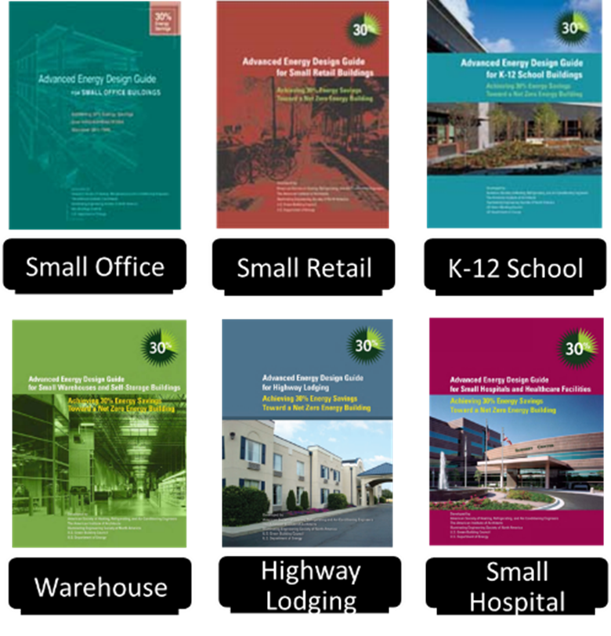
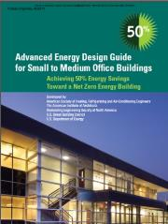
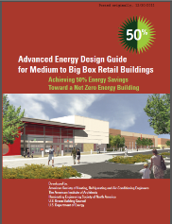
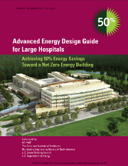
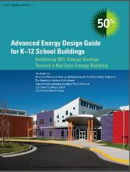
Advance Energy Design Guides
Eleven guides published and available for download: www.ashrae.org/freeaedg
Circulation is 600,000+ copies
?
Office
Med-Big Box Retail
Grocery Stores
Hospitals
K12 Schools
Notes:
The Advanced Energy Design Guides (AEDG) are a series of publications designed to provide recommendations for achieving energy savings over the minimum code requirements of ANSI/ASHRAE/IESNA Standard 90.1-1999. The guides have been developed in collaboration with these partnering organizations: The American Institute of Architects (AIA), the Illuminating Engineering Society of North America (IES), the U.S. Green Building Council (USGBC), and the U.S. Department of Energy (DOE). The New Building Institute (NBI) participated only in the development of the Advanced Energy Design Guide for Small Office Buildings.
The “Guide” is intended to provide a simple and easy approach for use by contractors and designers who design and construct small commercial buildings. Application of the recommendations in the Guide should result in small buildings with 30% energy savings when
compared to those same buildings designed to the minimum requirements of Standard 90.1-2004.

Slide 8
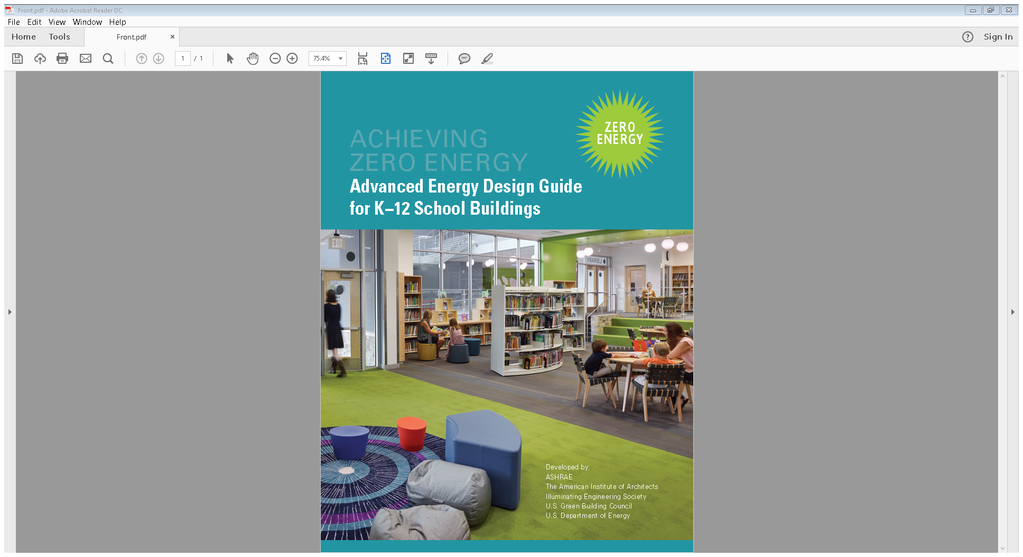

Slide 10
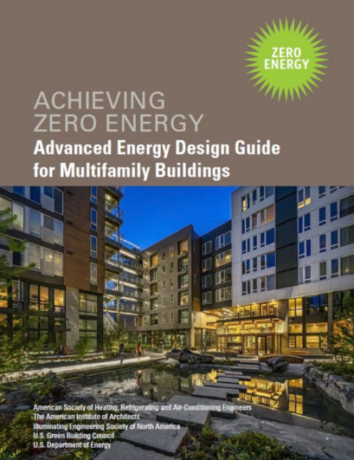

Slide 11
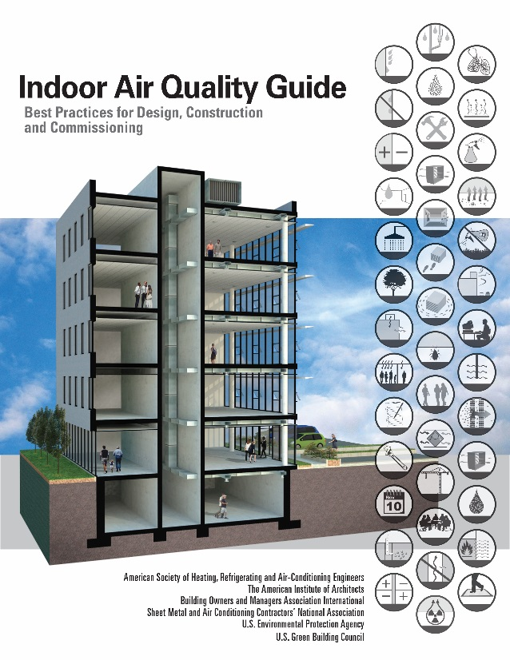
“FREE” ASHRAE Publications
AEDG
ZERO-ENERGY
IAQG
www.techstreet.com/ashrae
Notes:
While you can certainly buy them, the Advanced Energy Design Guides and Indoor Air Quality Guides can be downloaded for free from the ASHRAE Bookstore website. jc

Slide 12
Energy Balance Boundary
Legend
Electricity Heating energy
Cooling energy
Fuels
On-site renewable energy
Energy Use
Building Systems
Energy use and production
System losses and conversions
Delivered Energy (Renewable & non-renewable)
Building Needs
Heating Cooling Ventilation DHW Lighting Plug Loads Processes
≤
Exported Energy (Renewable)
Energy transfer within boundary
Energy transfer entering or leaving boundary
Source: A Common Definition for Zero Energy Buildings
Notes:
Figure 3-3 Energy Balance Diagram, Source: A Common Definition for Zero Energy Buildings.
Redrawn in PowerPoint

Slide 13
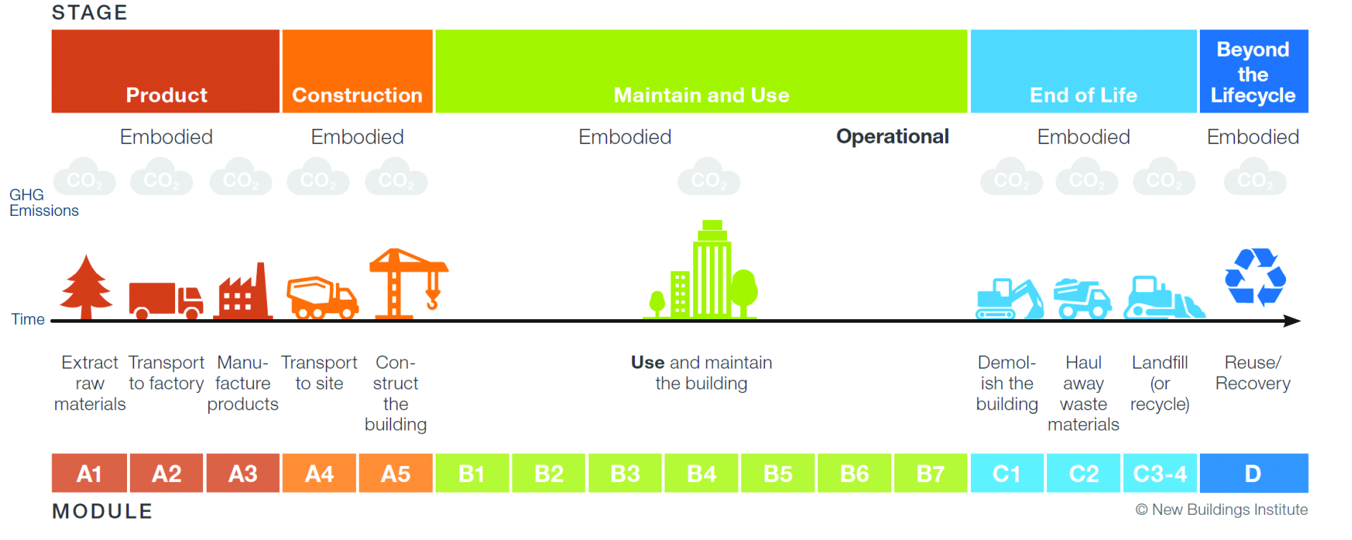

Slide 14
AEDG FOR Schools – Zero Energy
FUNDAMENTAL PRINCIPLES
Zero Energy Schools can create and reinforce a culture for zero energy among those who use and operate them.
Zero Energy Schools demand highly collaborative
synergies among those who plan, design,
construct, operate and maintain them.
Connect Teaching & Learning to Zero Energy

Slide 15
AEDG FOR Schools – Zero Energy
EXAMPLES OF HOW-TO STRATEGIES
Recommended Daylight Design Criteria
SPACE MIN. sDA300 MAX ASE
Classrooms 75% 15%
Gyms/Multi-use 55% 25%
Library Reading 55% 25%
Admin Offices 55% 15%
Cafeterias 55% 25%
sDA – Spatial Daylight Autonomy (lux)
ASE – Annual Sunlight Exposure (lux,hrs)

Slide 16
AEDG FOR Schools – Zero Energy
EXAMPLES OF HOW-TO STRATEGIES
Luminaire Strategies (LED, Solid State Luminaires (SSL))
Lighting Controls/Digital Addressable Lighting Interface (DALI) Control Protocol
Lighting Power Densities (LPD)
Plug Load Management
Kitchen Equipment

Slide 17
AEDG FOR Schools – Zero Energy
EXAMPLES OF HOW-TO STRATEGIES
Service Water Heating – Gas/Electric Storage or Instantaneous, Heat Pump
HVAC Systems & Equipment w/DOAS
1. Chilled/Hot Water system w/Single Zone
AHUs
2. Air-Source VRF Multi-split H-P System
3. GSHP System

Slide 18
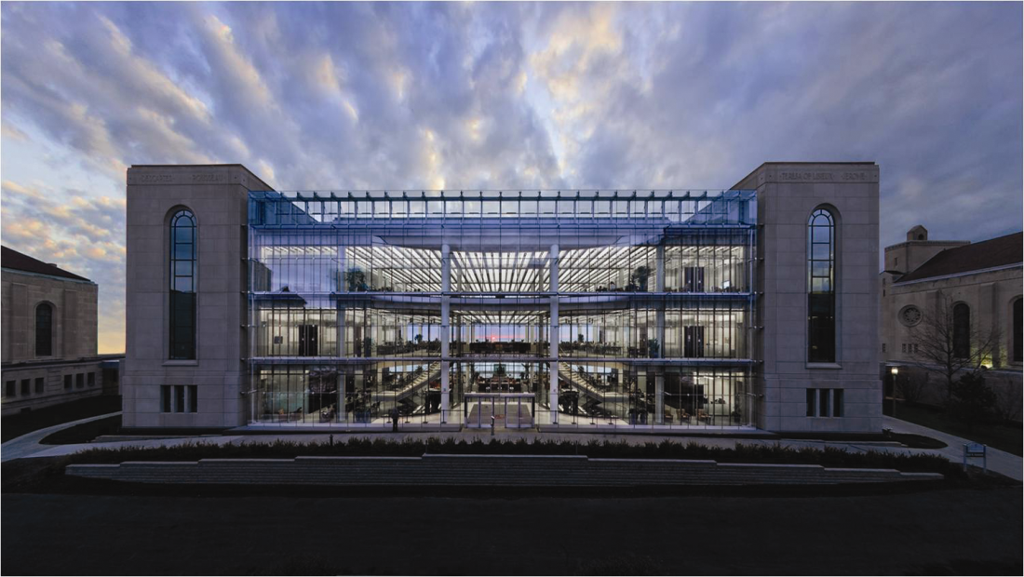
R.J Klarchek Information Commons Bldg
70,500 sq.ft. 4-Story 24/7 Digital Library
Double-skin West Curtain Wall; Single-skin East Curtain Wall
Classrooms in “Bookends”
Partitioned Group Study Areas – Center
Ground Floor Café
Vegetative Roof
Hillside, IL
Loyola University
Indoor Experience ≈ Being Outdoors on a Beautiful Day

Slide 19
R.J Klarchek Information Commons Bldg
Energy Efficiency
Dual Temp Radiant Ceiling – PEX Tubing
Ducted Underfloor Air System – Ventilation & Supplement Radiant Cooling
Radiant Cooling – Return Water from Central Chiller Plant
Natural Ventilation & Hybrid Operation Modes – Automatic Operable Windows; Motorized Awning Windows → Indoor Temps ≈ ½ Degree of Outdoor Temps; Hybrid Op = Natural Ventilation + Radiant Cooling

Slide 20
R.J Klarchek Information Commons Bldg
Energy Efficiency
Automated Motorized Shading – Control of Venetian Blinds per Angle of Sun & Internal Roll-up Blinds (East Side) for Max Solar Heat Gain
Heat Recovery & Dehumidification – Heating Mode AHUs Function as DOAS w/Heat Recovery; Cooling Mode AHUs/VAV Boxes Controlled by CO2 Levels & Temp Over-ride (Chilled Ceiling Can’t Meet Sensible Loads); AHUs Dehumidify w/Run-around Coils

Slide 21
R.J Klarchek Information Commons Bldg
Energy Efficiency
Daylight Harvesting – Daylighting Control Maintains 35 fc → 50 fc w/Continuous Ltg Dimming/Adjustment per Space Conditions
Control Sequence – Detailed Sequences of HVAC & Smoke Evac Systems + Complete Weather Station (light levels, wind, TDP, TDB & Precipitation)
Large Ceiling Mass – Stores Night Harvested “Coolness” (Hybrid Ventilation)

Slide 22
R.J Klarchek Information Commons Bldg
Indoor Air Quality
Demand Controlled Ventilation via Under Floor Air Distr. System w/High Induction Swirl Diffusers
VAV Box Control Maintains CO2 ≤ 1,000 ppm
Zone Air Distribution Effectiveness = 1.0 (Table 6.2 of Std 62.1)

Slide 23
R.J Klarchek Information Commons Bldg
Maintenance & Operation
Accessible Raised Floor – All Open Areas
3rd Party Commissioning Process
Continuous Monitoring of Bldg Systems’ Operations & Alterations (as necessary)
Problematic Operations Discovered & Resolved by Staff
Sub-meters on ChW, Dual-temp Water & Electricity→Plug Loads Larger Than Expected

Slide 24
R.J Klarchek Information Commons Bldg
Cost Effectiveness
Low-flow Fixtures (1/8 gpm) = Reduced Waste
Dual Flush Toilets
Green Roof Area = Additional Insulation, Temp Control, Reduced Storm Water Runoff & Absorption of Solar Energy
Actual Bldg Performance →46% Better than ASHRAE 90.1-1999 (84 kBTU/SF/yr of which Plug Loads = 24 kBTU/SF/yr)
Bldg → Most Popular on Campus

Slide 25
Net-Zero Richardsville Elementary School Bowling Green, Kentucky
PROJECT DESCRIPTION
72,300 sq.ft. facility for 500 elementary school students
2-story facility with initial goal of annual consumption of 18 kBtu/sf-year
NZEB STRATEGIES
Geothermal HVAC System using dual compressor WSHP units
Ventilation w/100% O/A, variable volume, heat recovery unit; Use of CO2 Sensors/continuous testing of IAQ
Thermal envelope – ICF wall construction

Slide 26
Net-Zero Richardsville Elementary School Bowling Green, Kentucky
NZEB STRATEGIES
Daylighting – Combination of Glazing + Solatubes
Lighting Power Density = 0.68 W/ft2
Kitchen – Type II hoods installed – reduced exhaust air requirements; most efficient cooking equipment installed
Computers – Fist wireless school in KY (all laptops)
Power Generation – 208 KW of roof mounted thin film solar photovoltaics and 140 KW of mono-crystalline photovoltaic panels
LESSONS LEARNED
Energy reduction opportunities – Kitchen power, Computers & Ventilation system/control

Slide 28
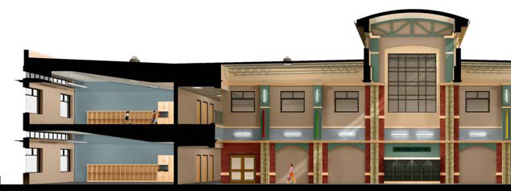
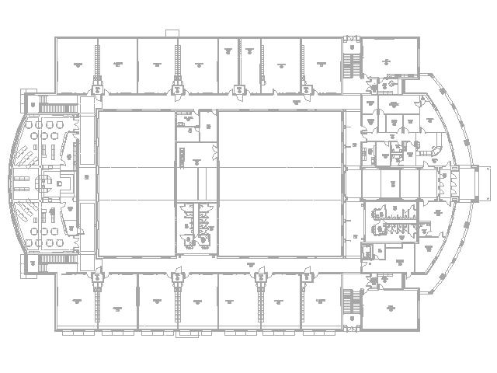
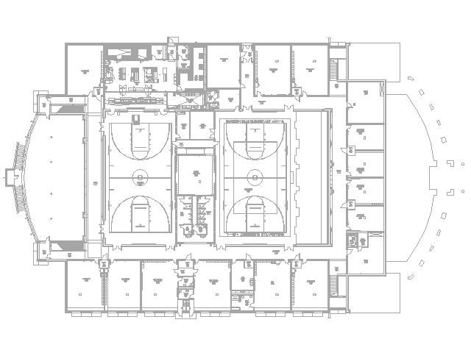
Main Level Lower Level

Slide 29
Net-Zero Richardsville Elementary School Bowling Green, Kentucky
Measured Energy Use
Annual Energy Consumption = 357,000 kWh/yr
Renewable Annual Energy Supply = 366,000 kWh/yr
Net Energy Use = (9,000 kWh/yr)

Slide 30
Net-Zero NREL Administration Building
PROJECT DESCRIPTION
218,000 SF that includes one 3-story and one 4-story office wing
Building Occupancy = 780
NZEB STRATEGIES
Cross Ventilation Strategies
Hydronic radiant slab heating and cooling
DOAS in a displacement ventilation configuration

Slide 31
Net-Zero NREL Administration Building
NZEB STRATEGIES
Ventilation air preheat w/collectors on S-face of buildings
Remote mass thermal storage (heat & coolth)
Evaporative cooling for data center w/heat recovery
Daylight harvesting + window shading
Thermally massive exterior wall assemblies

Slide 32
Net-Zero NREL Administration Building
NZEB STRATEGIES
Portion of hot water heating by woodchip biomass boiler
Photovoltaic arrays on building roofs and Visitor’s Parking Lot →NREL to have Power Purchase Agreement from a 3rd party vendor
Use of ‘Lightlouver’ – a light bouncing device to augment daylighting

Slide 33
Net-Zero NREL Administration Building
LESSONS LEARNED
Energy loads dominated by “plug loads” and other internal loads (server rooms/data center)
Simple solutions are the “best” (e.g. transpired collectors vs double-skin south façade for solar control & passive heat collection)

Slide 34
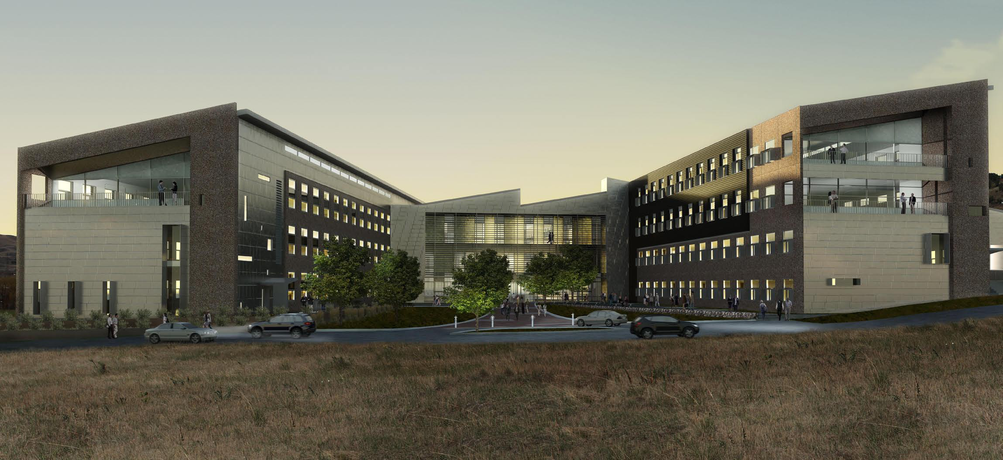

Slide 35
Net-Zero NREL Administration Building

Slide 36
Net-Zero NREL Administration Building

Slide 37
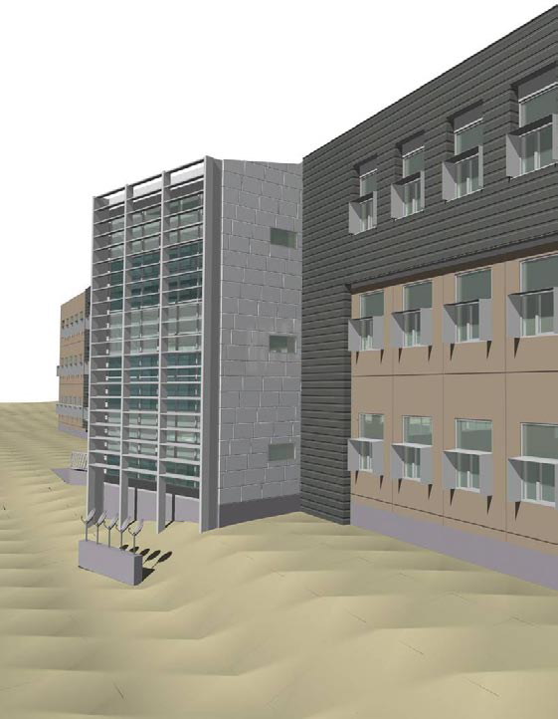
Net-Zero NREL Administration Building
Measured Energy Use
Annual Energy Consumption = 2,001,240 kWh/yr
= 9.18 kWh/SF-yr
Renewable Annual Energy Supply = 2,001,240 kWh/yr
= 9.18 kWh/SF-yr
Net Energy Use = 0 kWh/yr
(Excess sold to 3rd party)

Slide 38
Advanced Energy Design Guidance

Slide 39
Major Energy Uses in a Large Hospital
Where are the savings?
Red: Reheat
Green: Fans
Blue: Cooling
Yellow: Interior lights
Top Black: Pumps
Source: 50% AEDG Large Hospitals from ASHRAE
Notes:
Here is a figure showing energy comparisons between the baseline and lower energy models.
What are the big energy savers?
Click: (red) Reheat – if we don’t have methods to reduce or eliminate reheat it’s very unlikely that 50% savings will be achieved
Click: (green) fans – There is a lot of air movement required in healthcare facilities, so well designed and controlled fan systems and efficient fans are significant savers
Click: (blue) cooling – Economizer use and turning areas of the building that do not operate 24 hours per day are important to achieve significant savings
Click: (yellow) interior lighting – While many hospitals have installed more efficient lighting technology – there are still savings available. We’ll look at some examples in a few minutes
Click: (top black) pumps – when cooling and heating are reduced, so is the need for pumping.

Slide 40
How-To Tips
Source: 50% AEDG for Large Hospitals from ASHRAE
Notes:
OK, we’ve had times to briefly examine the recommendation tables.
Is that all there is to the AEDGs? Just two pages per climate zone?
Absolutely not. Here we look at the Small and medium office building 50% AEDG recommendation for a fan-coil system with a dedicated outdoor air system. There is a recommendation for “VAV fan coil units?” What does that mean?
In the right-most table column are the “How-to” tips.
There are tips for all the different sections (envelope, plug loads, etc.)
As we dig into HV8 we find:
Fan coils should be equipped with a variable-speed fan
For ducted fan-coils the fan power should be low (0.3 W/cfm) and to minimize chilled water system pumping the coil ΔT should be at least 14⁰ F
This is the type of information we can use to provide energy savings to building owners.

Slide 41
Aggressively Address Reheat
Supply dry air to OR
Recover heat from chilled water system
Source: 50% AEDG Large Hospitals from ASHRAE
Notes:
From a mechanical perspective it became very clear that aggressive concentration on reheat was necessary to reduce energy use to the desired levels.
So either room air needs to be dried, but not cooled, or the heating energy needs to be recovered.

Slide 42
50% AEDG for Large Hospitals WSHPs with DOAS
WSHPs with two-stage or variable-speed compressors and variable-speed fans
≥ 4 tons, but encouraged for smaller units also
Cooling: 17.6 EER (part load), 15.0 EER (full load)
Heating: 5.7 COP (part load), 5.0 COP (full load)
Dedicated OA system
Deliver air cold when possible
Exhaust-air energy recovery (60% effective)
Demand-controlled ventilation
Notes:
Water-source heat pumps (WSHP) with a dedicated outdoor-air system (DOAS):
WSHPs should have variable-speed fans (or at least multiple speeds).
Units 4 tons and above should have variable-speed or two-speed compressors. Note that units with variable-speed compressors may have lower full load cooling and heating efficiencies since their part load performance is improved. Below 4 tons, variable-speed compressors are encouraged.
The dedicated outdoor air system deliver the air cold whenever possible. This is so that reheating of the air does not occur when the cool air can be used to offset space cooling load.
In addition, both exhaust air energy recovery (60% effectiveness) and demand-controlled ventilation should be part of the DOAS.

Slide 43
50% AEDG for Large Hospitals Fan-Coils with DOAS
Multiple-speed or variable-speed fans
Chiller plant
Chiller: 6.50 COP (0.54 kW/ton)
15°F chilled water ΔT
14°F condenser water ΔT
Variable-speed cooling tower fans
Control to minimize chiller + tower energy
Dedicated OA system
Deliver air cold when possible
Exhaust-air energy recovery (60% effective)
Demand-controlled ventilation
Notes:
Fan-coils with a dedicated outdoor-air system (DOAS):
Fan coils should have either multiple-speed or variable-speed fan. This is becoming more prevalent with the use of electrically commutated motors (ECMs).
A high efficiency chiller at 0.54 kW/ton full load (at AHRI standard conditions) is recommended as are “low flow” or high ΔT systems. These help reduce pumping energy.
Variable-speed cooling tower fans are recommended, and they should be controlled to minimize chiller plus tower energy consumption.
The dedicated outdoor air system deliver the air cold whenever possible. This is so that reheating of the air does not occur when the cool air can be used to offset space cooling load.
In addition, both exhaust air energy recovery (60% effectiveness) and demand-controlled ventilation should be part of the DOAS.

Slide 44
50% AEDG for Large Hospitals Chilled-Water VAV System
Separate treatment of OA
Exhaust-air energy recovery (60% effective)
Demand-controlled ventilation
Chiller plant
Water-cooled heat recovery chiller: 4.55 COP
Water-cooled cooling-only chiller: 6.50 COP
15°F chilled water ΔT
14°F condenser water ΔT
Variable-speed cooling tower fans
Control to minimize chiller + tower energy
Notes:
Chilled-water VAV system:
Treat outdoor air separately and use exhaust air energy recovery with 60% effectiveness. This does not mean a separate unit. The next slide gives and example of outdoor air treatment. In addition demand-controlled ventilation should be used to reduce outdoor air usage when spaces have lower ventilation requirements.
Due to the air change requirement in hospitals, and the resultant need for reheat, a heat recovery chiller is recommended.
A high efficiency chiller at 0.54 kW/ton full load (at AHRI standard conditions) is recommended as are “low flow” or high ΔT systems. These help reduce pumping energy.
Variable-speed cooling tower fans are recommended, and they should be controlled to minimize chiller plus tower energy consumption.

Slide 45
Avoid Overventilation
Sensing technologies
CO2 sensors in densely occupied spaces
Occupancy sensors where population variation is minimal
Time-of-day for zones that are sparsely occupied or predicted occupancy patterns
Std 170
“Reduce airflow rates during unoccupied hours in surgery rooms and other spaces with minimum air-change requirements”
Maintain pressurization requirements

Slide 46
Guide Contents—Case Studies
Great River Medical Center
West Burlington, Iowa
700,000 ft²
190 inpatient beds, 8 operating rooms
Two 99,000-ft² medical office buildings
Heated and cooled with one of the largest lake-coupled geothermal system in the United States
1800 tons of cooling
85-mile long piping system
800 heat pumps
96 kBtu/ft²·yr whole-building energy use intensity
Average hospital is at about 240 kBtu/ft²·yr
$0.94/ft²·yr in utility costs
Average hospital is at about $2.39/ft²·yr
Notes:
s

Slide 47
Honoré-Mercier Hospital Saint-Hyacintha, Quebec

Slide 48
Honoré-Mercier Hospital
Building Information
* 135,000 SF Renovation + 90,000
SF New Construction
* 300 Beds; Emergency, ICU, ORs,
Labs, Nuclear Meds, Imaging,
Oncology, Sterilization, Food
Services, Clinics & Pharmacy
* Decontamination (Aspergillus) of Entire Facility

Slide 49
Honoré-Mercier Hospital
Building Energy Efficiency Measures
* Enthalpy Wheels & Run-around Coils in Exhaust Air
* Low Temp Heating Loop
* Dual Duct System
* Heat Recovery Chillers
* Heat Pumps
* High Efficiency Boilers
* Efficient Lighting Systems

Slide 50
Honoré-Mercier Hospital
Building Challenges
* Constant Negative Pressure in
Contaminated Areas
* External Areas (Walls)-Negative
Pressure; Internal Areas-Positive
Pressure→Use of Press. Sensors
& Constant Monitoring

Slide 51
Honoré-Mercier Hospital
Operational Results
* 43% Reduction in Energy Use
* Annual Cost Savings = $921,855
* Net Payback = 3.8 years
* GHG Reduction = 3,576 Tons/yr

Slide 52
Unique AEDG & Net-Zero Applications
AEDG APPLICATIONS
100 Howe Building – Corporate Call Center
Oracle Data Center
Dallas Semiconductor Manufacturing Complex
cGMP Cell Therapy Facility – Northwestern Univ.
NET-ZERO APPLICATIONS
Marin County K-8 Day School
Packard Foundation Office Complex
CSIRO Energy Center
Cellophane House

Slide 53
ZEB Technology Pathways for Commercial Buildings
Design Process Pathways
 | CODE | 30% Savings | 50% Savings | 70% Savings | 100% Savings
Design Guidance | 90.1 | 30% AEDGs | 50% AEDGs w/perform. optimization | Optimization Tools for Guidance | Optimization Tools incl’g renewable energy sources
Integrated Building Design | NONE | Suggested | Rec. to direct integrated design | Use of optimization tools for site specific designs | Fully integrated energy efficiency & optimization

Slide 54
ZEB Technology Pathways for Commercial Buildings
Technology Pathways
 | CODE | 30% Savings | 50% Savings | 70% Savings | 100% Savings
Roofs | R-15→R-25 | R-15→R-30 | R-20→R-35 | R-25→R-45 | R-25→R-45
Walls | R-2→R-15 | R-2→R-15 | R-10→R-30 | R-19→R-35 | R-19→R-35
Windows | 90.1 | U-0.5→U-O.33 SHGC:0.45→0.25 Vt/SHGC: 1 | U-0.4→U-0.2 SHGC:0.45→0.25 Vt/SHGC: 2 | U-0.3→U-0.13 SHGC:0.5→0.25 Vt/SHGC: 2.5 | U-O.3→U-0.13 SHGC:0.5→ 0.25 Vt/SCHGC: 2.5
Daylighting | None Spec’d | None Spec’d | 35% + daylight energy reduct | 60% + daylgt energy red. | 80% + daylgt energy red.

Slide 55
ZEB Technology Pathways for Commercial Buildings
Technology Pathways
 | CODE | 30% Savings | 50% Savings | 70% Savings | 100% Savings
Lighting | 90.1 | 10% LPD reduct. MLPW > 70 | 20% LPD red. MLPW> 80 | 30% LPD reduct. MLPW> 90 | 50% LPD reduct. MLPW>120
HVAC | 90.1 | 0—30% incr in efficiency | 30% incr eff w/climatic-specif secndry HVAC sys | 50% incr eff w/clim spec secndry HVAC sys | 50% incr in ttl HVAC eff w/clim spec HVAC sys
Outdoor Air | 90.1 | ERVs, DCV & econ on small HVAC | Reduc energy 50% assoc w/OA | Reduc energy 75% assoc w/OA | (Same as 70%)
Plug & Process | No change | Energy Star appliances | 10% peak red. & 30% nighttime red. | 15% peak & 40% night reductions | 25% peak & 60% night reductions

Slide 56
ZEB Technology Pathways for Commercial Buildings
Technology Pathways
Technology Pathways Table Notes:
Vt/SHGC = Ratio of Visible Transmittance to Solar Heat Gain Coefficient
MLPW = Mean Lumens per Watt lighting system (bulb, ballast system efficacy)
Renewables Table Wind Speed Classifications for U.S.
http://www.eere.energy.gov/windandhydro/windpoweringamerica/pdfs/wind_maps/us_windmap.pdf
 | CODE | 30% Savings | 50% Savings | 70% Savings | 100% Savings
Service Water Heating | 80% Et | 90% Et | 90% Et | 95% Et | 95% Et
Energy Storage | None | None | None | Create load factor of 50%+ | Create loaf factor of 75%+

Slide 57
ZEB Technology Pathways for Commercial Buildings
Renewables
 | CODE | 30% Savings | 50% Savings | 70% Savings | 100% Savings
PV | None | None | 0%→20% Bldg load | 20%→75% Bldg load | 75%+ Bldg load
Solar Hot Water | None | None | Solar Fraction = 0.5 (year around HW) | Solar Factor = 0.75 (yr around HW) | Solar Factor = 0.75 (HW) & 0.5 (rad. htg)
Site Wind | None | None | 0→10% Bldg load (wind class >4) | 20%+ Bldg load (wind class>4) | 30%+ Bldg load (wind class>3)
Site Biomass | None | None | None | 50%+ HW & space htg | 80%+ HW & space htg
Off Site Purchases | None | None | None | None | Meet bal of loads after renewables

Slide 58
ZEB Technology Pathways for Commercial Buildings
General Notes for All Tables:
For each level of savings, not every technology must be applied or is needed for every building in every climate. The pathways represent a range of performance likely to be needed across climate zones. Building and site-specific optimization tools can be used to determine the most cost-effective combination of pathways needed to reach energy savings goals.
Daylight Lighting Reduction: Percent reduction in annual lighting energy measured from sunrise to sunset. Includes the concept of “Daylighting Saturation Percent,” which is the percentage of occupied hours times the percentage of floor area that is fully daylit. “Fully daylit” is defined as daylighting that provides a minimum illuminance, but not more than a maximum illuminance (typically 400 footcandles). This metric includes the controls and related hardware necessary to achieve the savings from daylighting.

Slide 59
ZEB Technology Pathways for Commercial Buildings
General Notes for All Tables:
30% savings data based on 30% AEDGs.
50% savings data based on 50% grocery and medium box TSDs, experience with 50% designs from case studies, and Greensburg examples.
70% savings data based on expected diminishing returns for each technology pathway based on 50% design optimizations.
100% savings data based on ongoing ZEB research and attempting various ZEB designs at NREL’s new office building (RSF), Greensburg School analysis (ZEB goal), and ZEB case study database portal.
HVAC system efficiencies include all primary and secondary systems needed to provide heat/cold to the occupants. Includes compressors, supply fans, condenser fan and pumps, primary pumps, controls, dampers, etc., and includes controls to make systems operate to full operating potential.
Plug loads include traditional plug loads, elevators, transformers, and all other equipment that is not directly tied to lighting or HVAC. Efficiency gains could include DC power distribution.

Slide 60
Center of Excellence for Building Decarbonization (CEBD)

Slide 61
Operational Subcommittee
Five Working Groups, developing six (6) guides: (Released in 2023-24)
Grid Interactive Buildings for Decarbonization: Design and Operation Resource Guide: Complete
Decarbonizing Hospital Buildings: Complete
Decarbonizing Building Thermal Systems: A Guide for Applying Heat Pumps and Beyond: Complete
TM 65 for North America: Complete
Building Decarbonization Retrofits for Commercial and Multifamily Buildings: Nov/Dec 2024
Whole Life Carbon Guide for Building Systems: In Process
Added the Development of Training Open in 2025
Online training for the Guides
In-Person ALI Course
https://www.ashrae.org/about/cebd-technical-resources

Slide 62
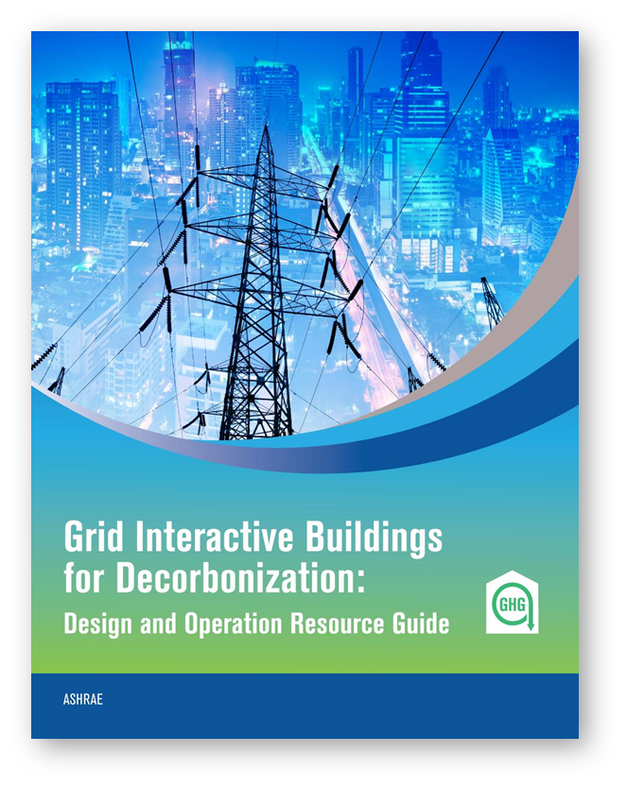
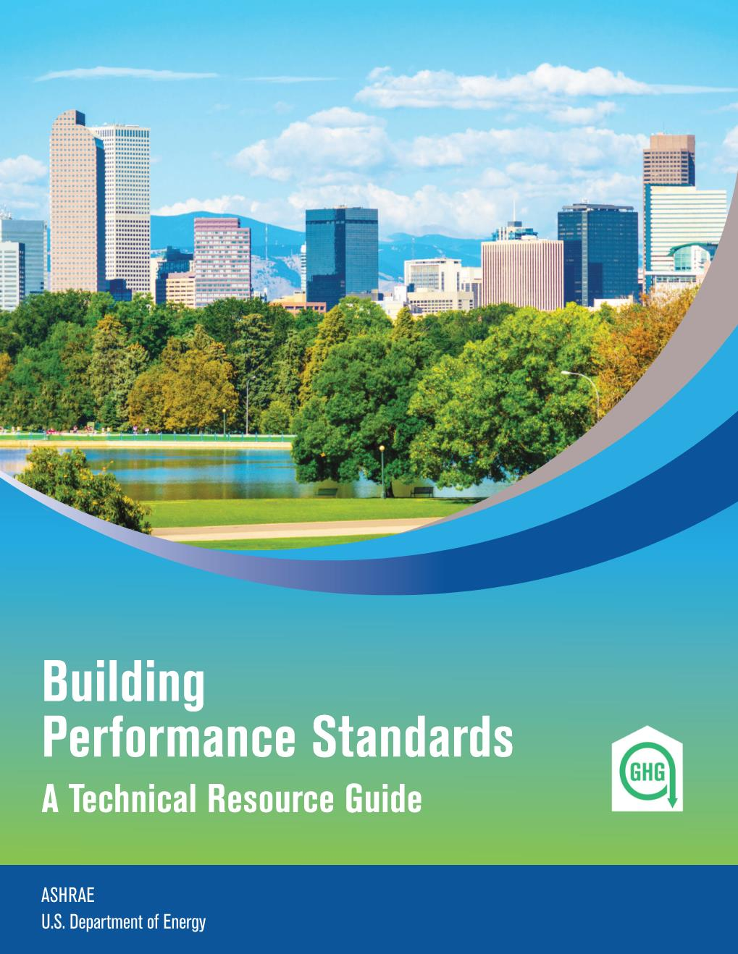
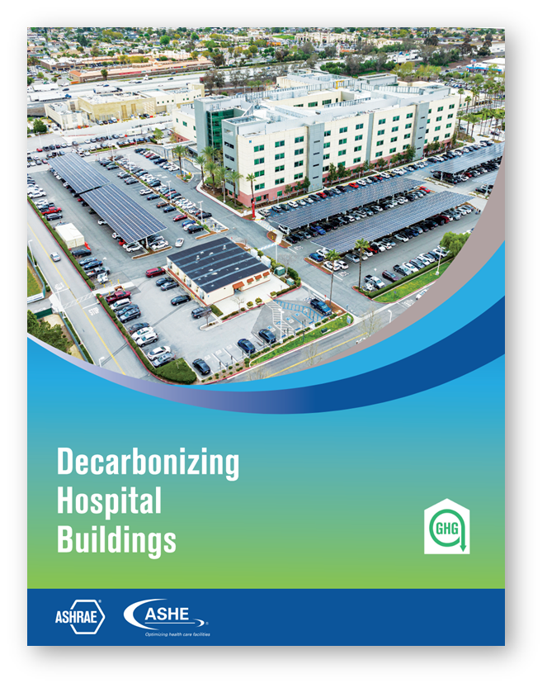
Technical Guides Update
Ready For Download!
Ready For Download!
Ready For Download!
Ready For Download!
https://www.ashrae.org/about/cebd-technical-resources
Notes:
The BPS and Decarbonizing building systems are available as free downloads on our site.

Slide 63
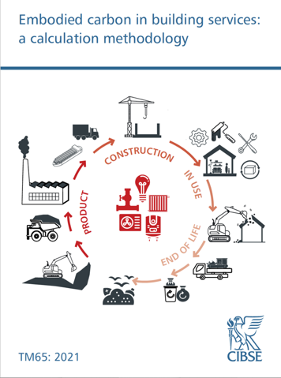
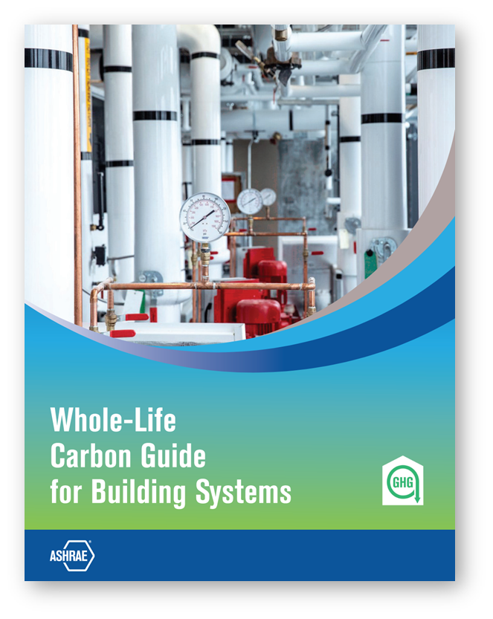
Technical Guides Update
for North America
Ready For Download!
Coming Soon!
Coming Soon!

Slide 65
NEW! ASHRAE Certification
Notes:
The CDP certification program validates competency of the decarbonization professional to do the following:
Assess, analyze, and develop effective and sustainable strategies that reduce/eliminate the life-cycle carbon footprint of new and existing buildings.

Slide 66
Learning Objectives
Objective 1: Explain the purpose of the ASHRAE Certified Decarbonization Professional (CDP) personnel certification.
Objective 2: List the benefits of the ASHRAE Certified Decarbonization Professional (CDP) certification for the professional, their employer and building owners.
Objective 3: Describe the five steps to earning and maintaining the ASHRAE Certified Decarbonization Professional (CDP) certification.

Slide 70
ASHRAE Staff Contact
Leigh Lain Walker
Manager of Building Decarbonization
lwalker@ashrae.org

Slide 71
Your Role, Your Duty and Your Responsibility
“Don’t ask yourself ‘what the world needs’, ask yourself what makes you come alive. And then go do that. Because what the world needs are people (engineers) who have come alive!”
Howard Thurman
“Remember Today….For It’s the Beginning of FOREVER”
Dante Alighieri, Inferno

